Slide 1
Bias correction of precipitation from regional climate model using quantile mapping
Jayshri Patel, J. Sanjay and R Krishnan
Centre for Climate Change and Research
IITM PUNE
7 march 2017

Slide 2
Statistical bias correction
Statistical bias correction of simulation data is broadly applicable to the climate impacts research.
Several bias correction method
  Delta change
  local intensity scaling
  analog methods
  fitted histogram equalization
  quantile mapping
The QM method has been widely used in hydrological impacts of climate change
( Dobler and Ahrens, 2008; Piani et al., 2010).
Notes:
since it offers crucial advantages for impact modelling applications compared to using raw climate model output.
One of the driving motivations for much downscaling is
the investigation of regional and local hydrological impacts
of climate change (Fowler et al., 2007). Since the runoff response
to changing precipitation is highly nonlinear (Wigley
and Jones, 1985), changes in precipitation are amplified in
their convolution to runoff changes.

Slide 3
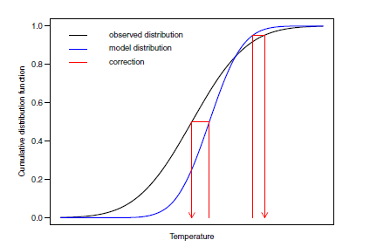
Quantile mapping
QM is an empirical statistical technique that matches the quantile of an Climate Model simulated value to the observed value at the same quantile
QM can alter the Climate Model driven
mean change (Pierce et al. (2015)
Extreme events (Hagemann et al.,2011; Maraun, 2013; Cannon et al.,2015).
Notes:
However some studies demonstrated that
Quantile mapping algorithms are commonly used to
bias correct daily precipitation series from climate models
so that distributional properties more closely match those
of historical observations.
QM bias correction is
an empirical statistical technique that matches the quantile
of an AGCM simulated value to the observed value at
the same quantile.
As noted earlier, we do not claim that the GCM projected
or bias-corrected trends are physically realistic,
only that the QM can alter the underlying GCM
trends considerably as an artifact of its application. if goal is to reproduce relative trends in precipitation extremes
as originally simulated by a climate model, then
the use of standard QM for bias correction cannot be
recommended. Instead, some form of quantile mapping
that takes into account future trends, minimally in the
mean, or, more comprehensively, in all quantiles, is
preferred.

Slide 4
Detrended quantile mapping (DQM)
If Projected value falls outside the historical range
Removes long-term mean trends from projected values variables
Apply quantile mapping for the Detrended values,
introduced the removed long-term mean trends

Slide 5
List of Regional climate model driven with CIMP AOGCM

Slide 6
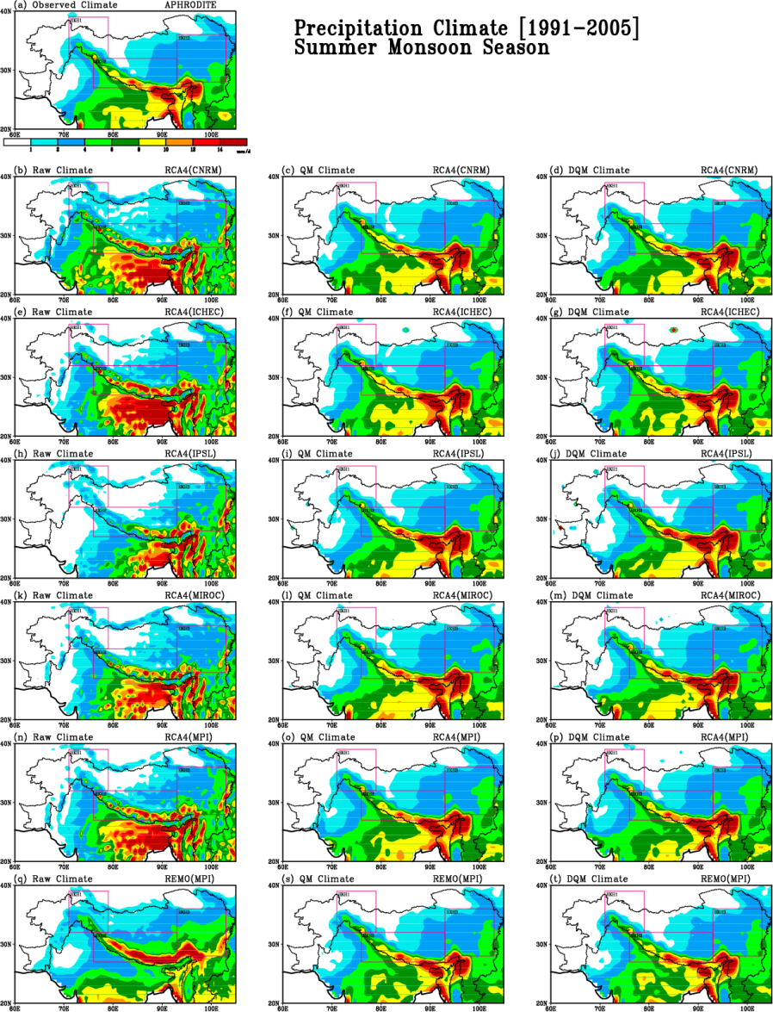
Mean climatology for JJAS precipitation
for 1991–2005 for the raw RCM output and Bias corrected QM and DQM
Calibration period - Jan 1976 to Dec1990
Validation. period - Jan 1991 to Dec 2005

Slide 7
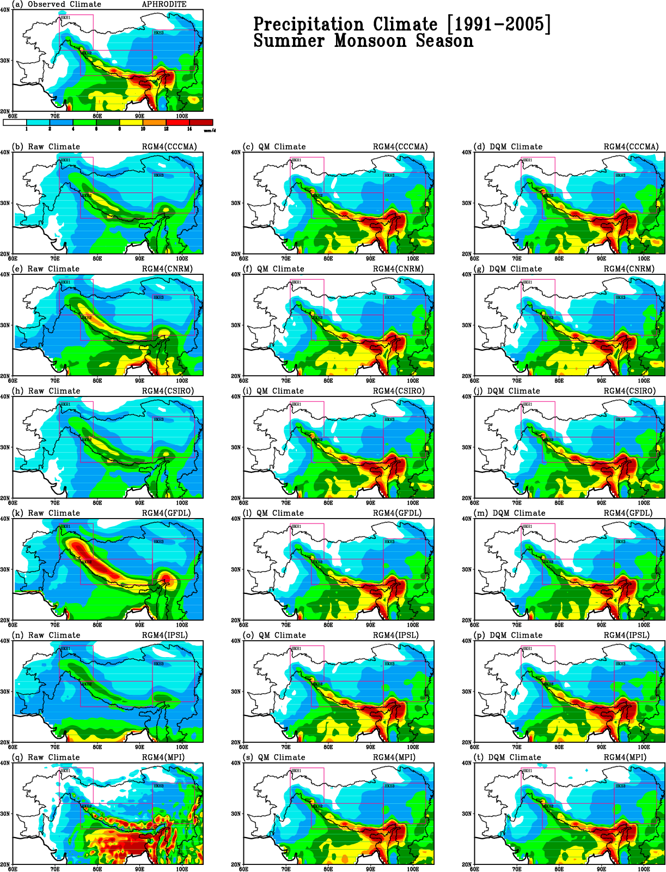
Mean Climatology for JJAS precipitation
for 1991–2005 for the raw RCM output
and Bias corrected QM and DQM

Slide 8
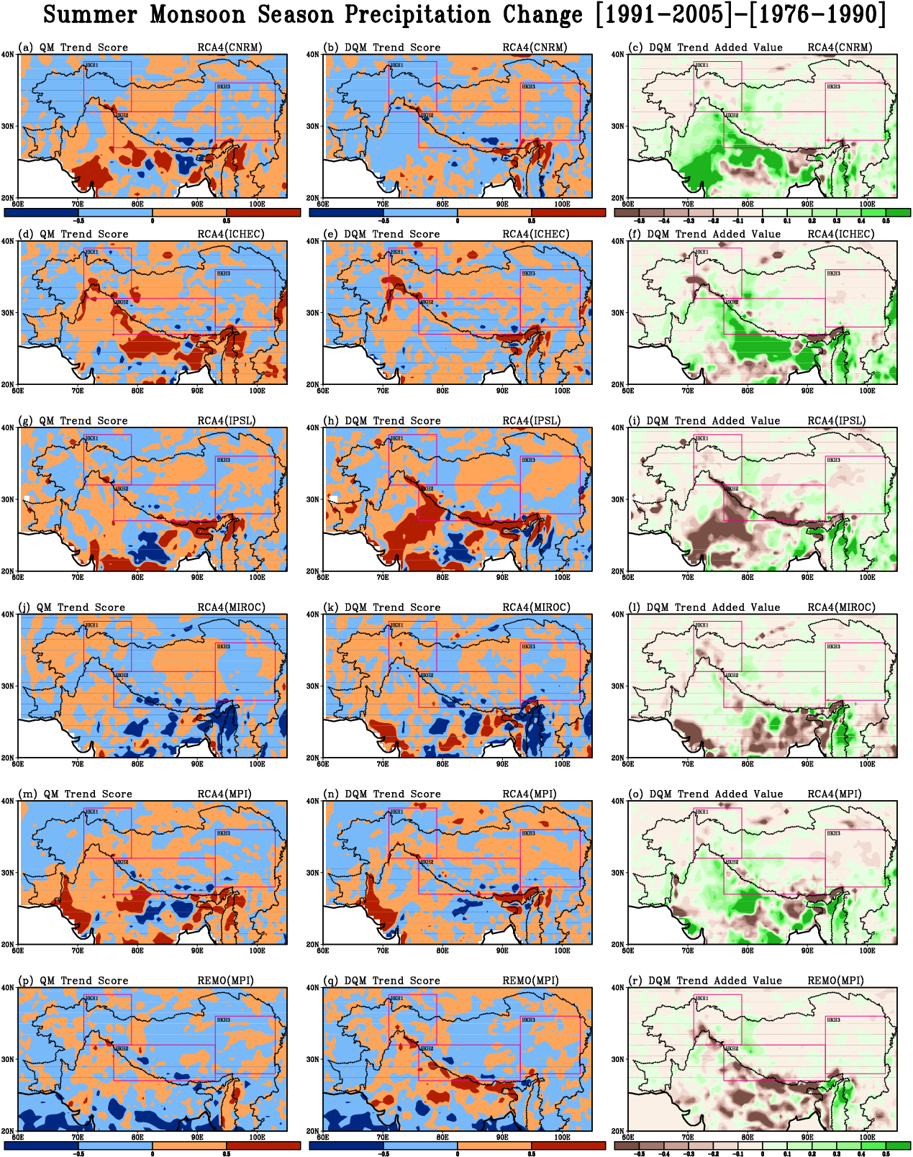
The TM index using QM (left)
an DQM (middle)
Added value (right)
TM values > 0 bias correction degrades
TM values < 0 bias correction improves
In order to quantify the added value of Detrended Quantile Mapping over the QM.
If TM index is smaller for DQM than QM , if AV is positive
Added valued = TM_{DQM} - TM_{QM}

Slide 9
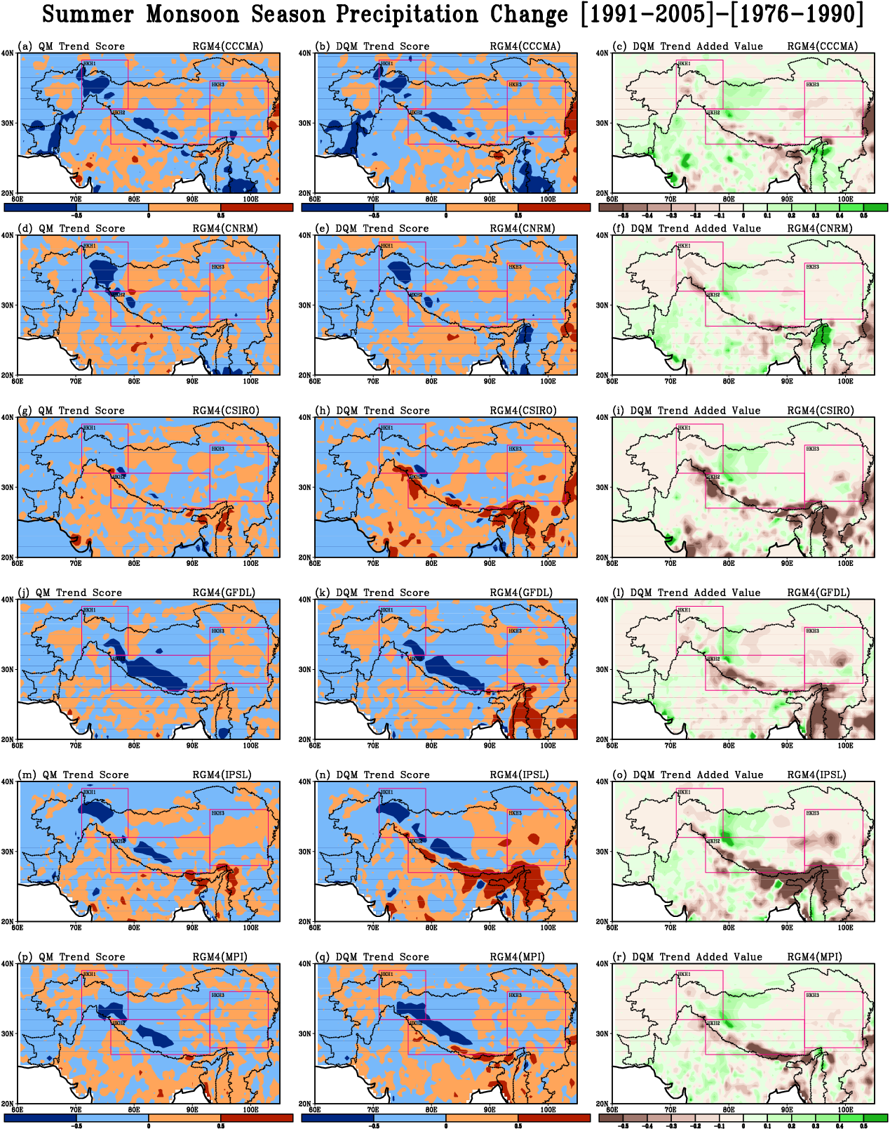
The Trend Modification index using QM (left) and DQM (middle)
Added value (right) for Summer

Slide 10
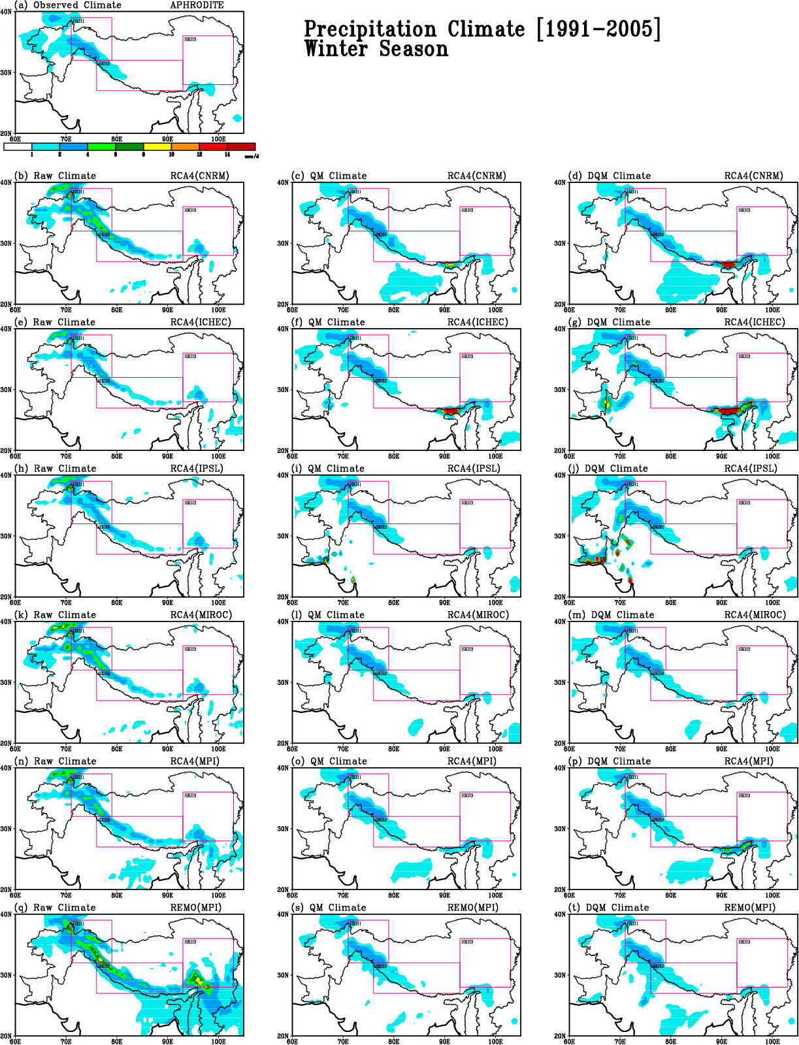
Climatology for DJF precipitation
for 1991–2005 for the raw RCM output and Bias corrected QM and DQM

Slide 11
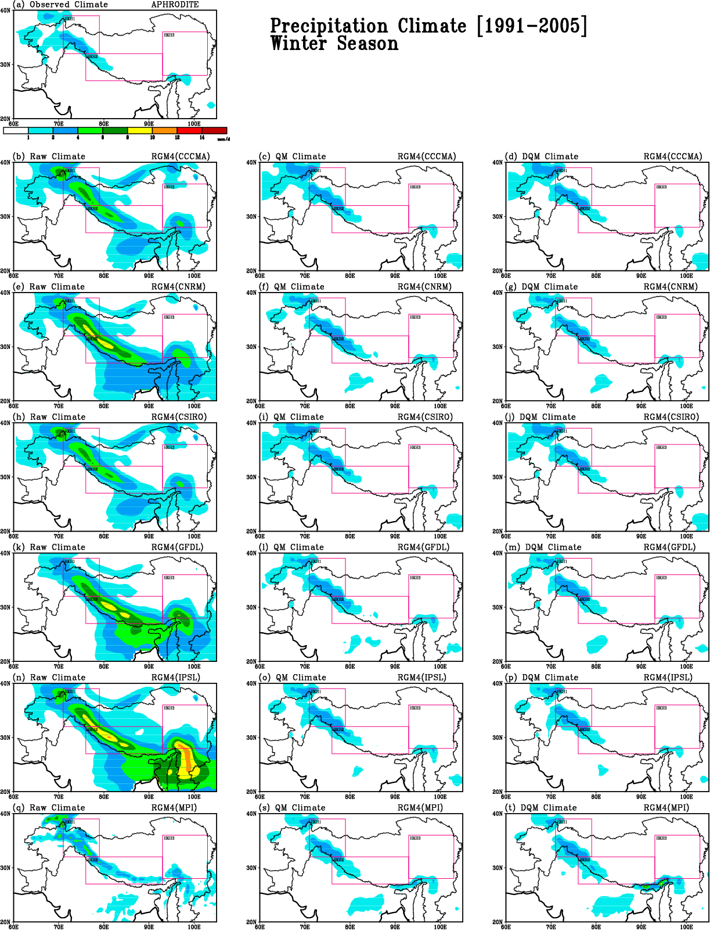
Climatology for DJF precipitation
for 1991–2005 for the raw RCM output and Bias corrected QM and DQM

Slide 12
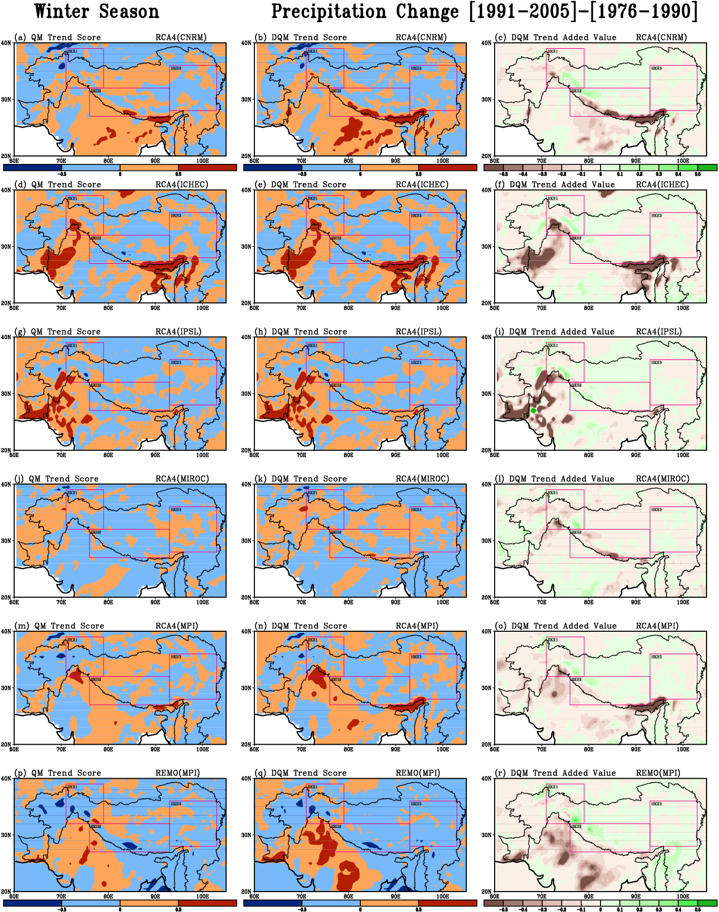
The Trend Modification index using
QM (left) and DQM (middle)
Added value (right) for Winter

Slide 13
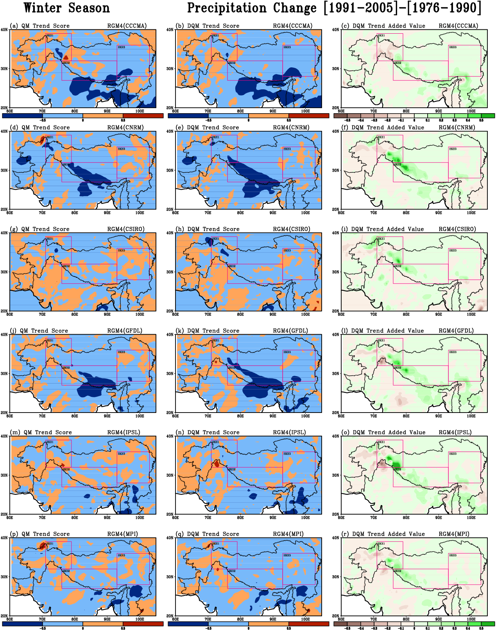
The Trend Modification index using
QM (left) and DQM (middle)
Added value (right) for winter

Slide 14
Summary
Trend modification index with improved or degraded change vary from model to model as well as region to region for both QM and DQM.
No clear difference can be seen to apply Detrended Quantile mapping over Quantile mapping .

Slide 15
Thank You

